Slide 1
Strategies for Developing Cross-Platform Applications
Hardik Mistry
Technology Consultant, Mobility & Cloud
@mistryhardik05

Slide 2

Who is this guy?
Hardik Mistry
Technology Consultant, Mobility & Cloud
mistryhardik.05@live.com
@mistryhardik05

Slide 3

Cross-Platform Mobile Development
Building high-quality Apps is hard:
Different presentation styles, interaction styles and software stacks
Devices have different screen sizes, input modes and hardware capabilities
New devices and OS versions are introduced multiple times per year
Network connectivity and power levels fluctuate widely in typical usage scenarios
New consumer applications regularly extend and revise the standards and set the bar higher for good mobile applications

Slide 4
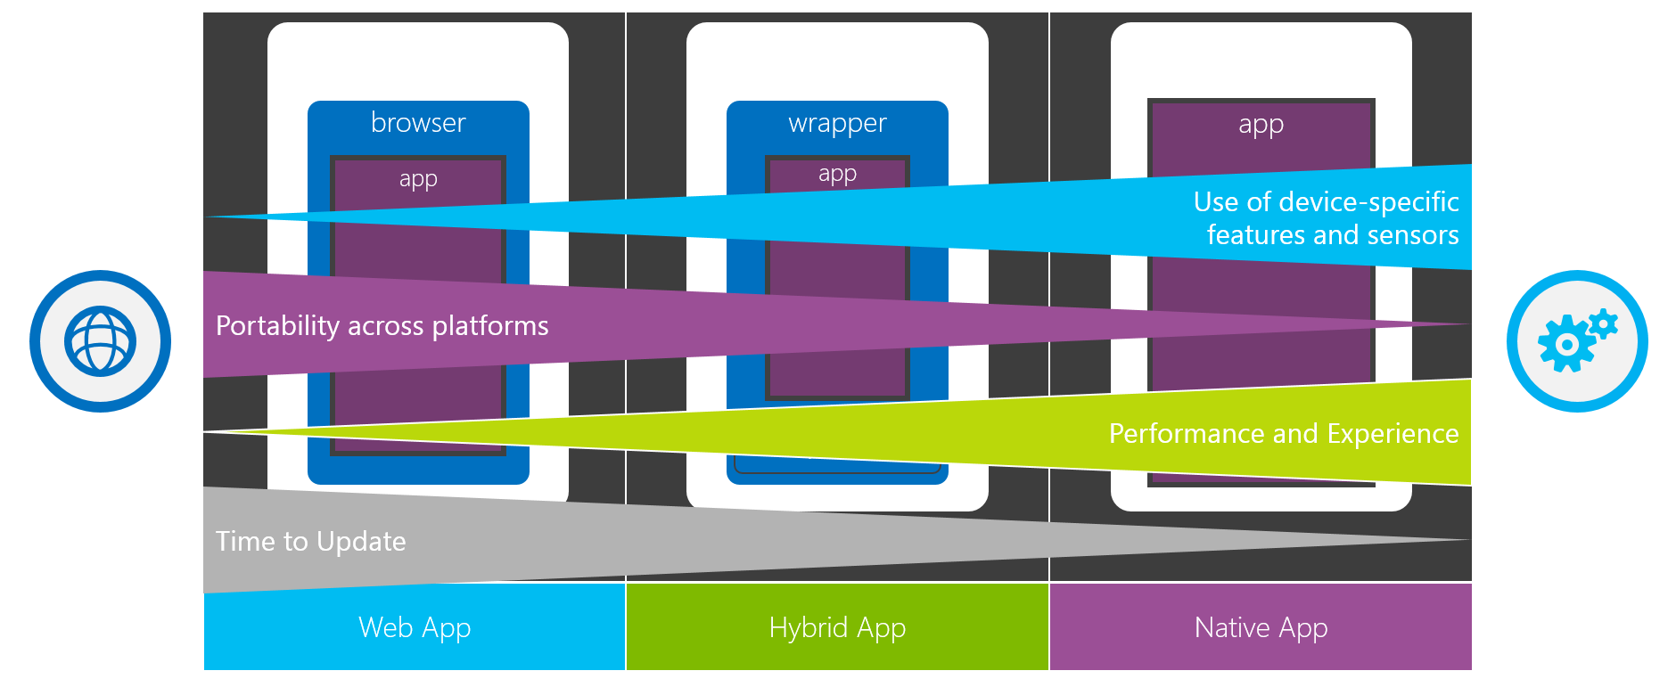
Client Technology Choices

Slide 5
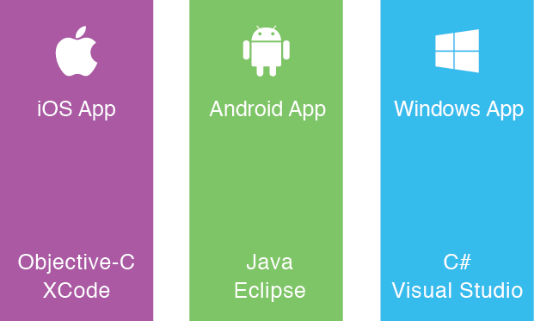
The “Siloed” Approach: Build App Multiple Times
Expensive to staff multiple platform-specific teams
Expensive to maintain multiple code bases
Slows innovation

Slide 6

The Write-Once-Run-Anywhere Approach
Poor user experience
– API coverage
– Performance
High abandonment rates
Wasted investment

Slide 7


Xamarin Approach
iOS C# UI
Android C# UI
Windows C# UI
Xamarin.Forms
Shared App Logic
Shared App Logic
Traditional
Xamarin.Forms

Slide 8


Xamarin exposes 100% of the native APIs for iOS, Android and Windows

Slide 9
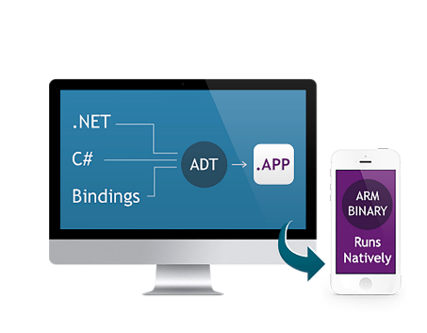


Native Performance
Xamarin.iOS does full Ahead Of Time (AOT) compilation to produce an ARM binary for Apple’s App Store.
Xamarin.Android takes advantage of Just In Time (JIT) compilation on the Android device.

Slide 10




Support Native APIs
Same day support:
iOS 5, iOS 6, iOS 7, iOS 7.1, iOS 8, iOS 9, iOS 10
Also:
Google Glass
Android Wear
Amazon Fire TV
Outros…

Slide 11
What we didn’t talk about
Xamarin Insights
Xamarin Test Cloud
Xamarin.Forms
Xamarin Component Store
Xamarin Studio (for MacOS)
Xamarin integration with Visual Studio

Slide 12

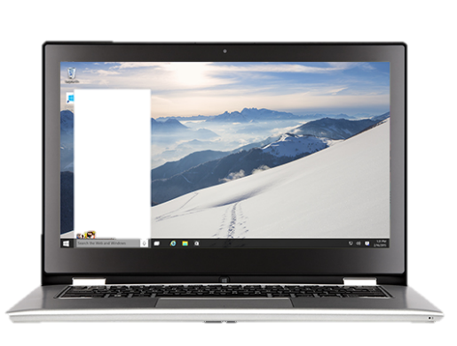
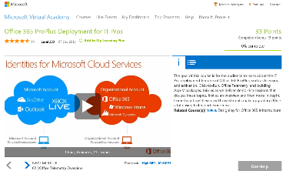
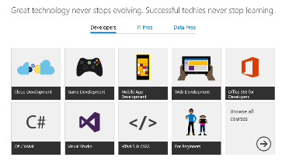
Microsoft Virtual Academy
www.microsoftvirtualacademy.com
Cross-Platform Development with Xamarin & Visual Studio
Cross-Platform Development with Visual Studio

Slide 13


Try Azure for Free
Download
Visual Studio 2017
Download
Visual Studio Code
http://aka.ms/tryazure

Slide 14
Thank you!
Hardik Mistry
@mistryhardik05

